Slide 1
KENNEDY MBUGUA
KENKIN1672@GMAIL.COM
TECHCRUSH
CLOUD COMPUTING TRACK
YEAR 2025
CAPSTONE PROJECT
IAM Roles and Secure Access Automation

Slide 2
IAM Roles and Secure Access Automation
Objective:
Automate the setup of secure identity and access controls using Azure CLI and Bash scripting.
Tasks:
1. Create a resource group, virtual network, and two subnets (Web and DB).
2. Create Azure AD groups: 'WebAdmins' and 'DBAdmins'.
3. Assign Reader role to DBAdmins for DB subnet resources.
4. Add test users to the AD groups and validate role assignments.

Slide 3
Tasks:
1. Create a resource group, virtual network, and two subnets (Web and DB).
LOCATION="eastus"
RG_NAME="IAMResourceGroup"
VNET_NAME="IAMVNet"
SUBNET_WEB="WebSubnet"
SUBNET_DB="DBSubnet"
SUBNET_PREFIX_WEB="10.0.1.0/24"
SUBNET_PREFIX_DB="10.0.2.0/24"
VNET_PREFIX="10.0.0.0/16"
WEB_ADMINS="WebAdmins"
DB_ADMINS="DBAdmins"
USER1=" kennedy.mbugua@jamesngigioutlook.onmicrosoft.com "
USER2="Mr.temiloluwa@jamesngigioutlook.onmicrosoft.com"

Slide 4
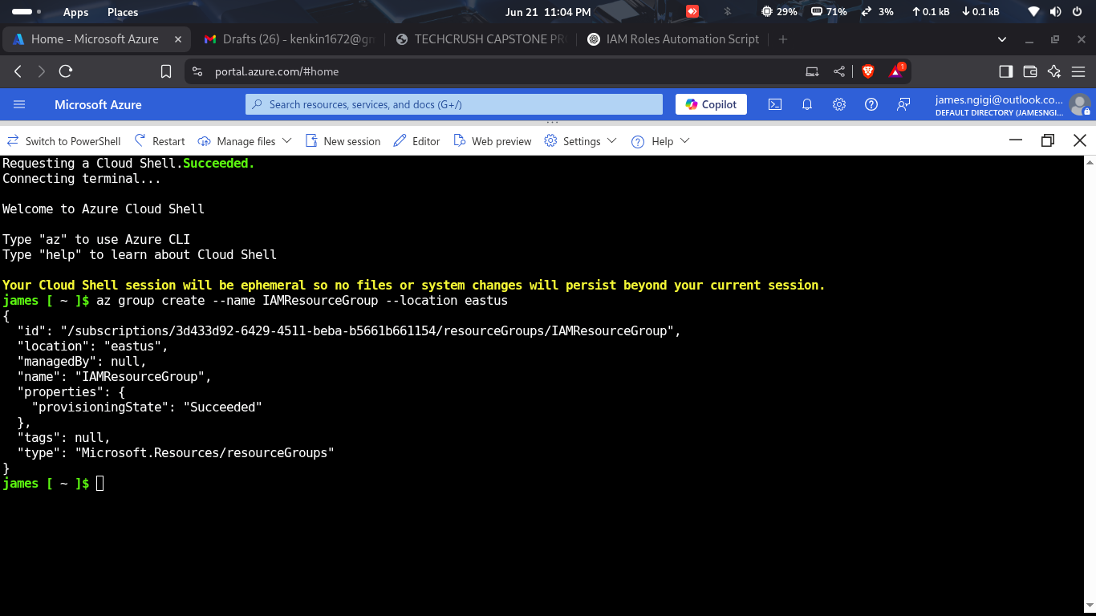
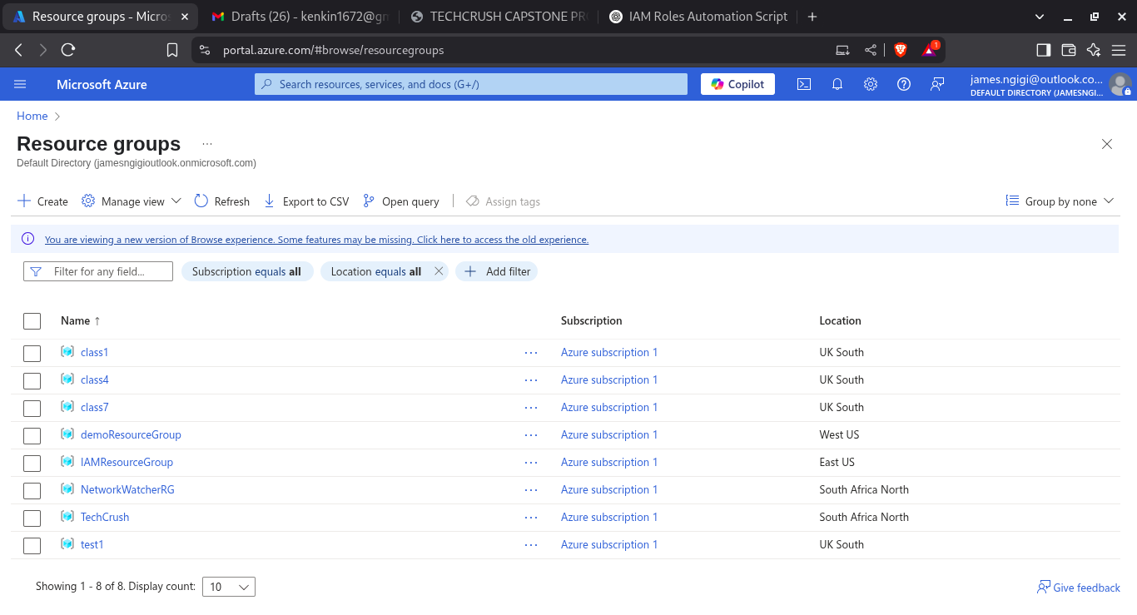
CREATING A RESOURCE GROUP
SCRIPT USED TO CREATE A RESOURCE GROUP.
az group create --name IAMResourceGroup --location eastus

Slide 5
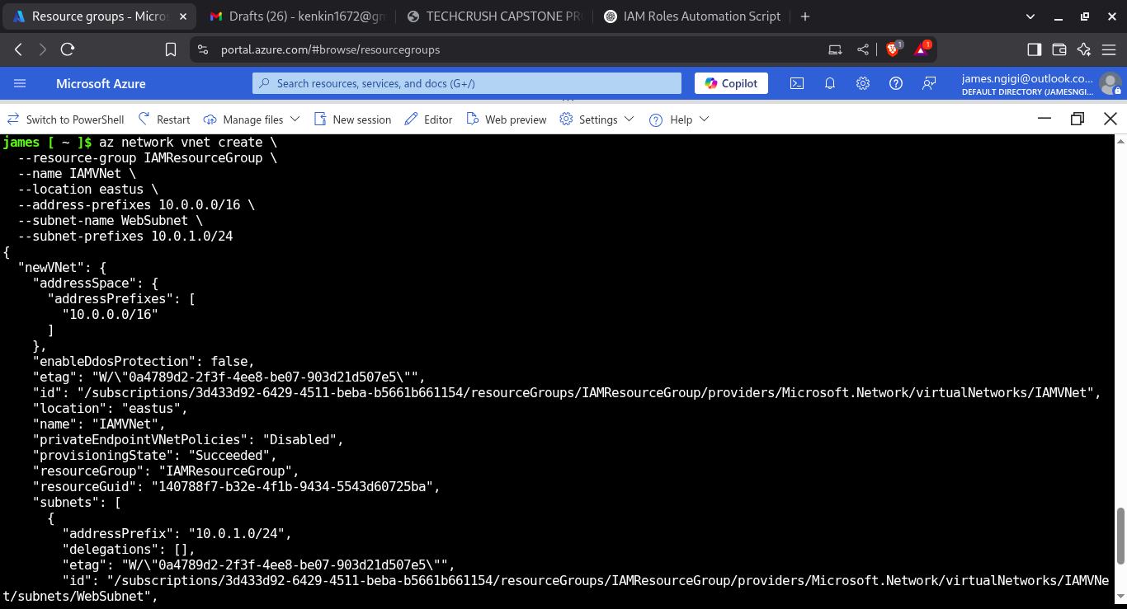
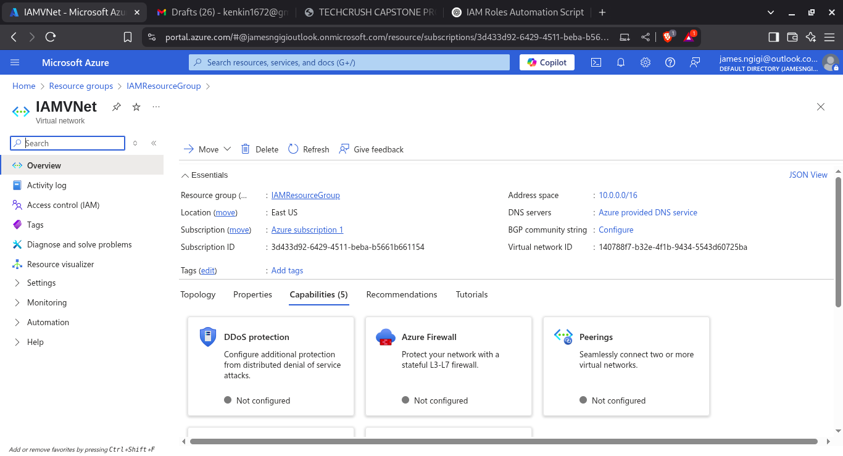
CREATING A VIRTUAL NETWORK.
SCRIPT USED TO CREATE A VIRTUAL NETWORK.
az network vnet create
--name IAMVNet
--resource-group IAMResourceGroup
--location eastus
--address-prefix 10.0.0/16

Slide 6
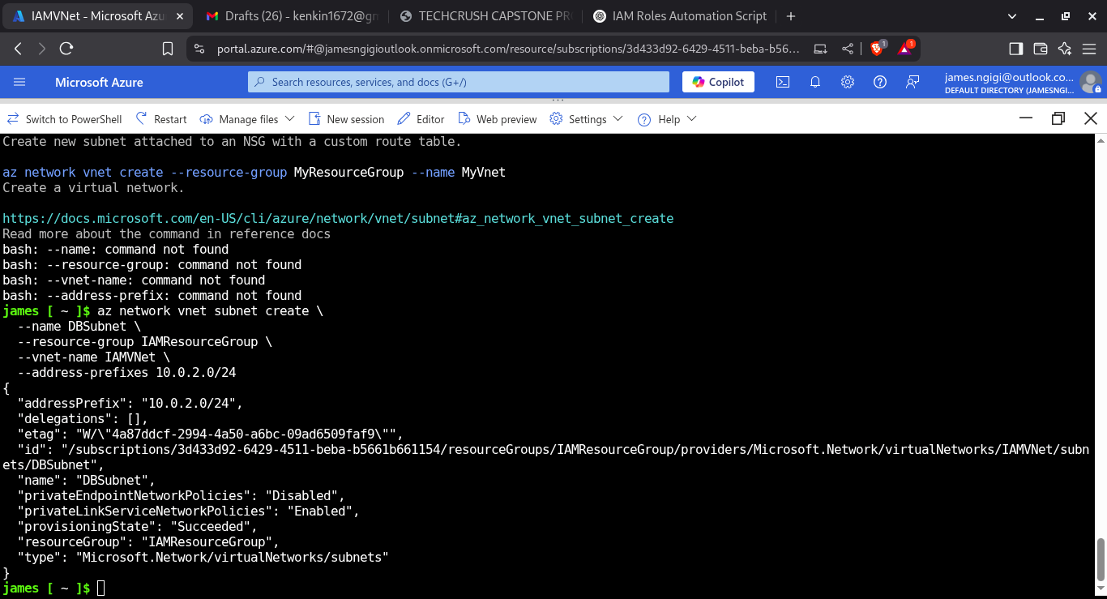
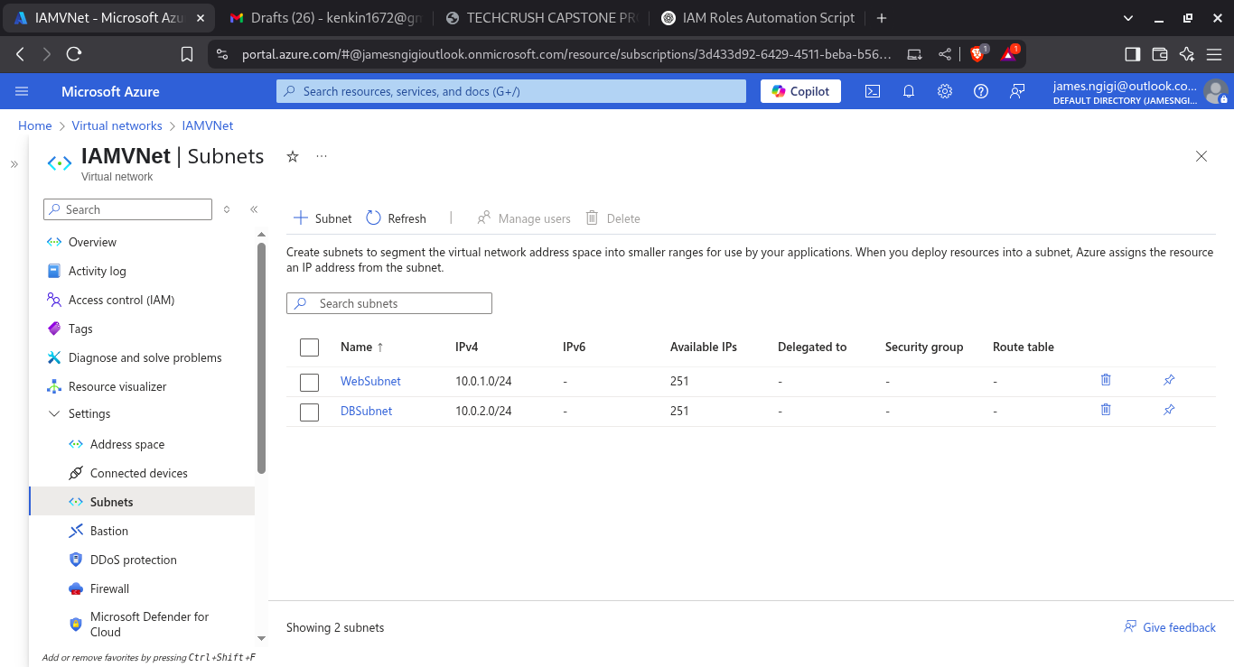
CREATING TWO SUBNETS
DBSubnet
SCRIPT USED TO CREATE A DBSUBNET.
az network vnet subnet create
--name DBSubnet
--resource-group IAMResourceGroup
--vnet-name IAMVNet
--address-prefix 10.0.2.0/24

Slide 7
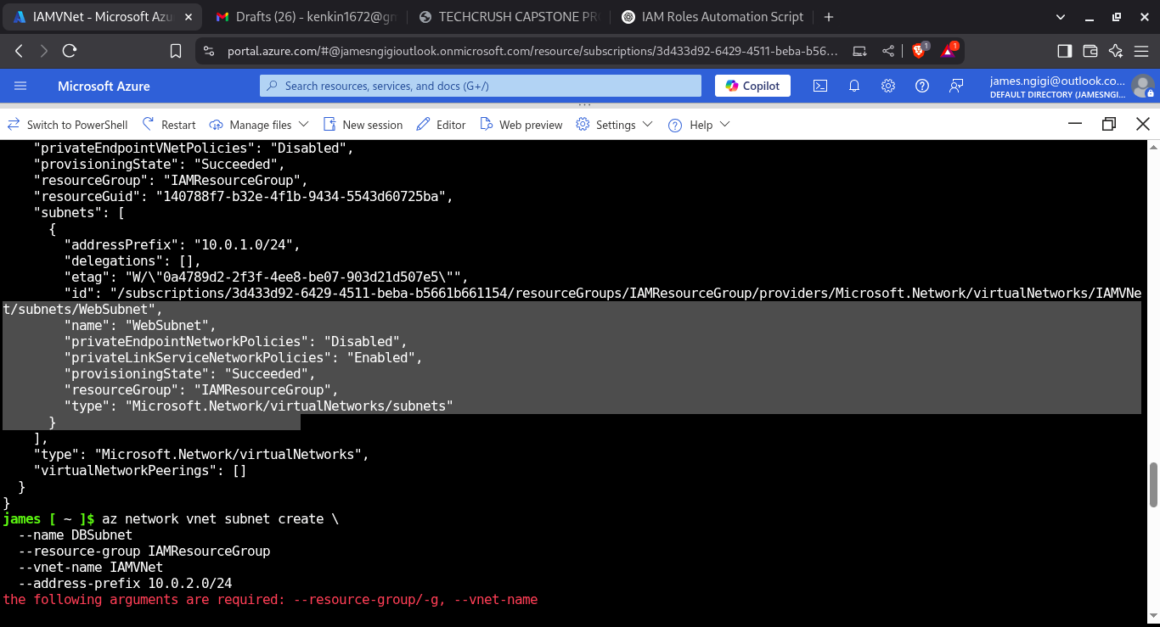
WebSubnet
SCRIPT USED TO CREATE A WEBSUBNET.
az network vnet subnet create
--name WebSubnet
--resource-group IAMResourceGroup
--vnet-name IAMVNet
--address-prefix 10.0.1.0/24

Slide 8
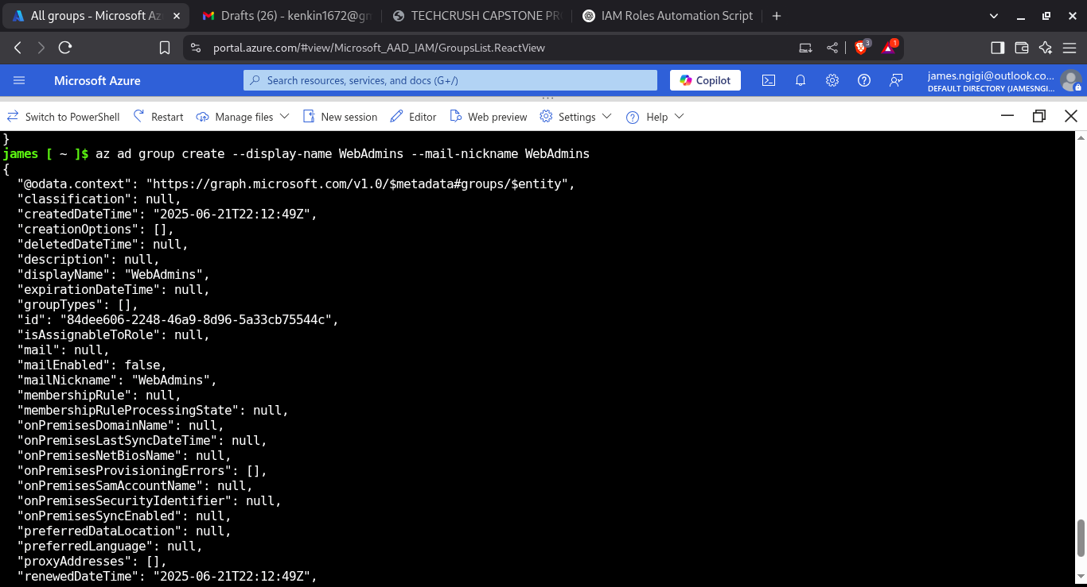
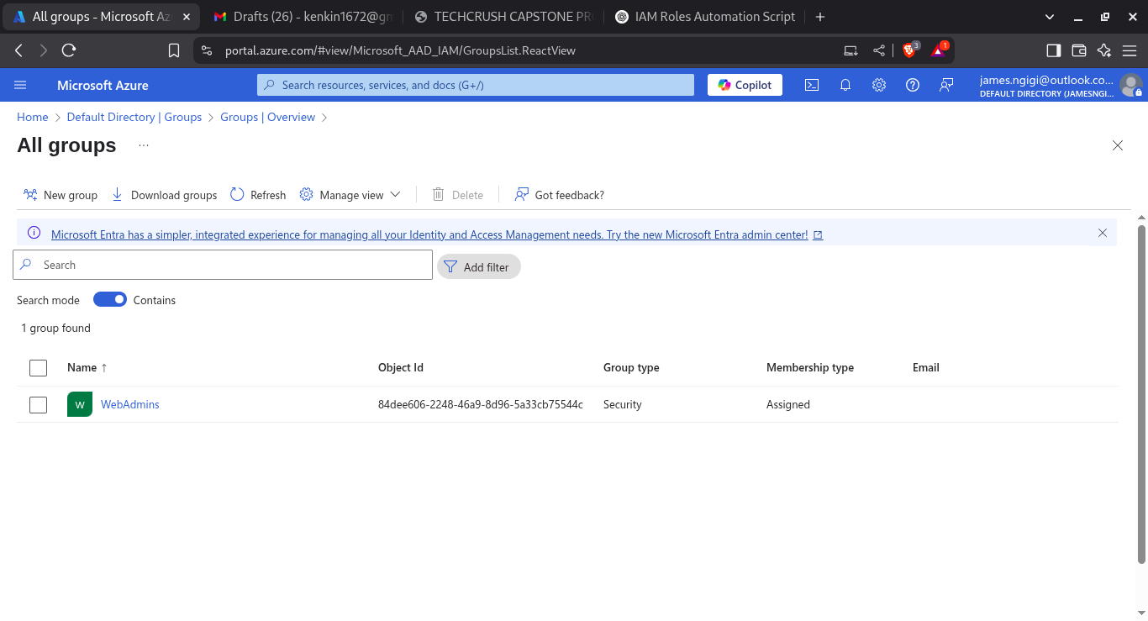
2. Create Azure AD groups: 'WebAdmins' and 'DBAdmins'.
CREATING WEBADMINS GROUP
SCRIPT USED TO CREATE A WEBADMINS GROUP.
az ad group create --display-name WebAdmins --mail-nickname WebAdmins

Slide 9
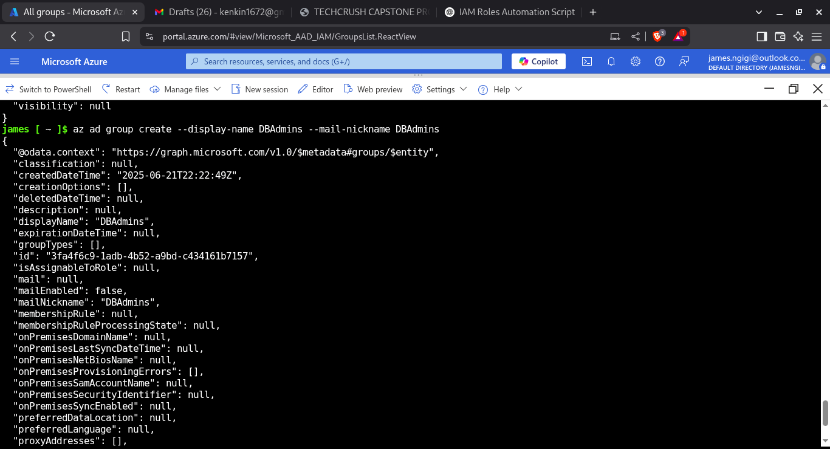
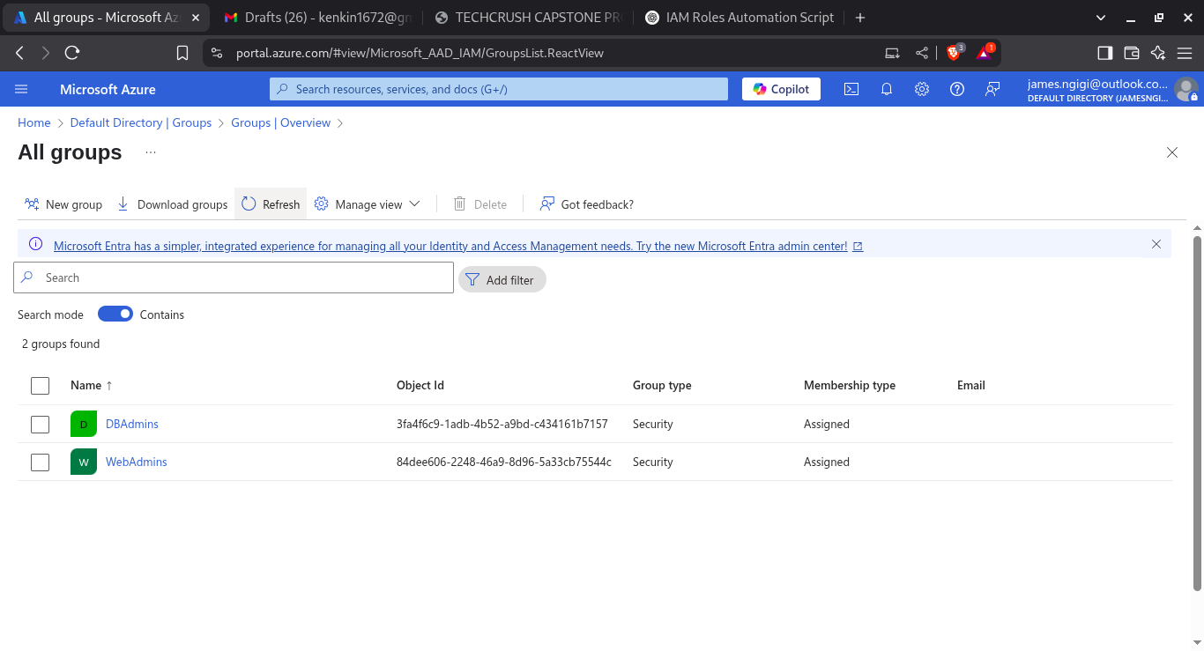
CREATING DBADMINS GROUP
SCRIPT USED TO CREATE A DBADMINS GROUP.
az ad group create --display-name DBAdmins --mail-nickname DBAdmins

Slide 10
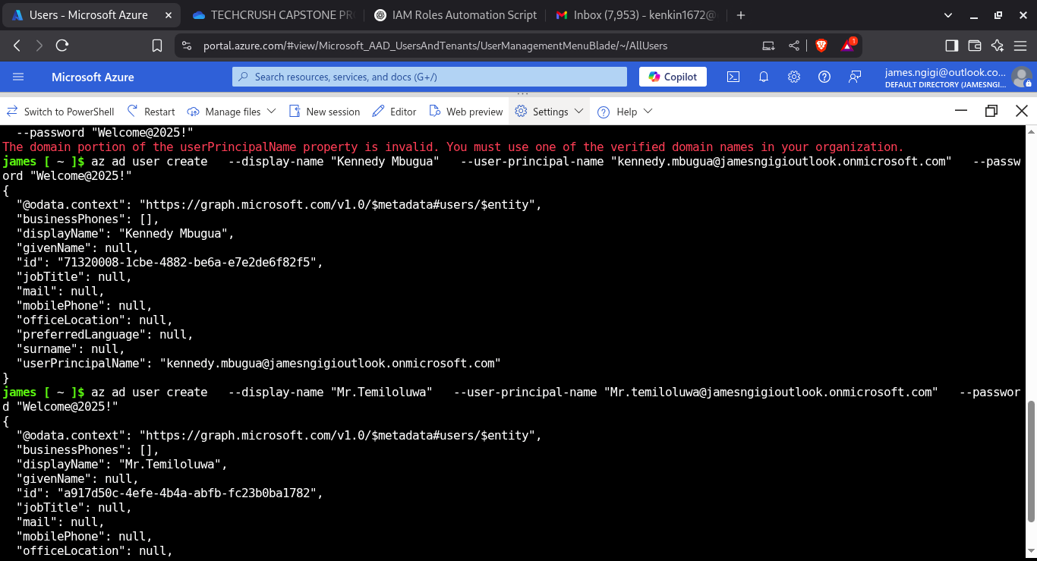
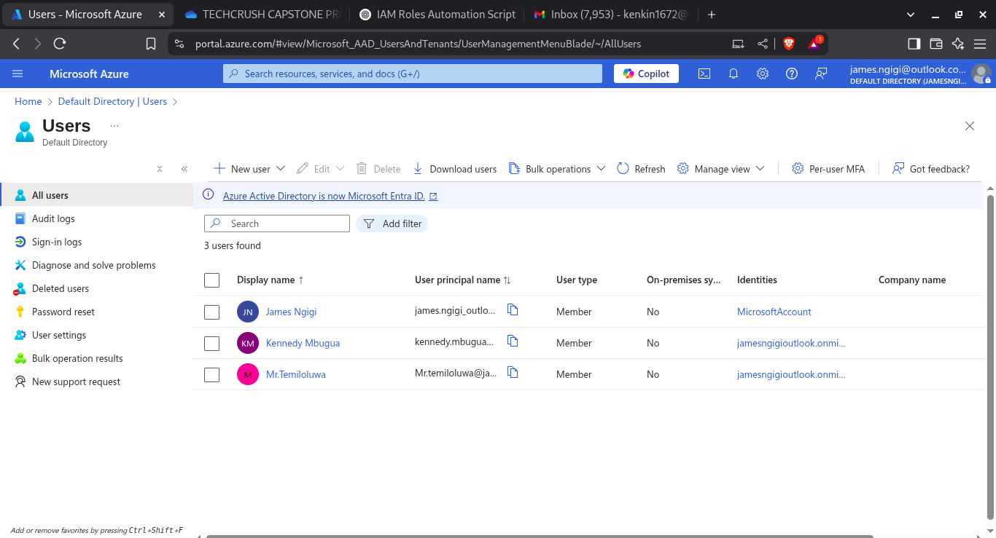
4. Add test users to the AD groups and validate role assignments.
CREATING USERACCOUNTS
SCRIPT TO ADD TEST USERS .
az ad user create --display-name "Kennedy Mbugua" --user-principal-name "kennedy.mbugua@jamesngigioutlook.onmicrosoft.com" --password "Welcome@2025!“
az ad user create --display-name "Mr.Temiloluwa" --user-principal-name "Mr.temiloluwa@jamesngigioutlook.onmicrosoft.com" --password "Welcome@2025!"

Slide 11
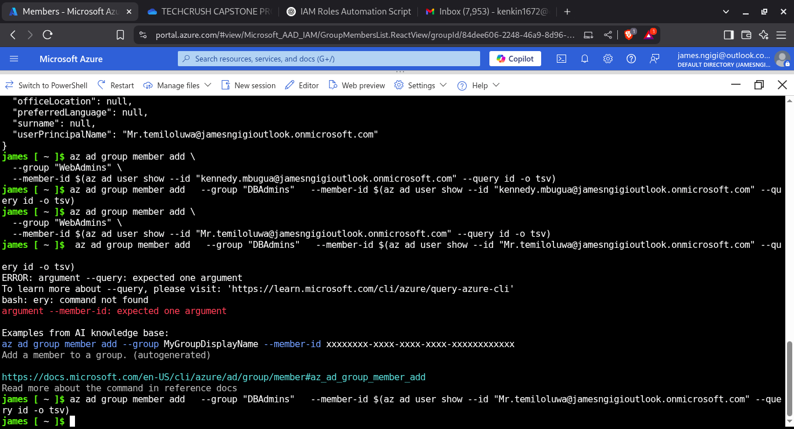
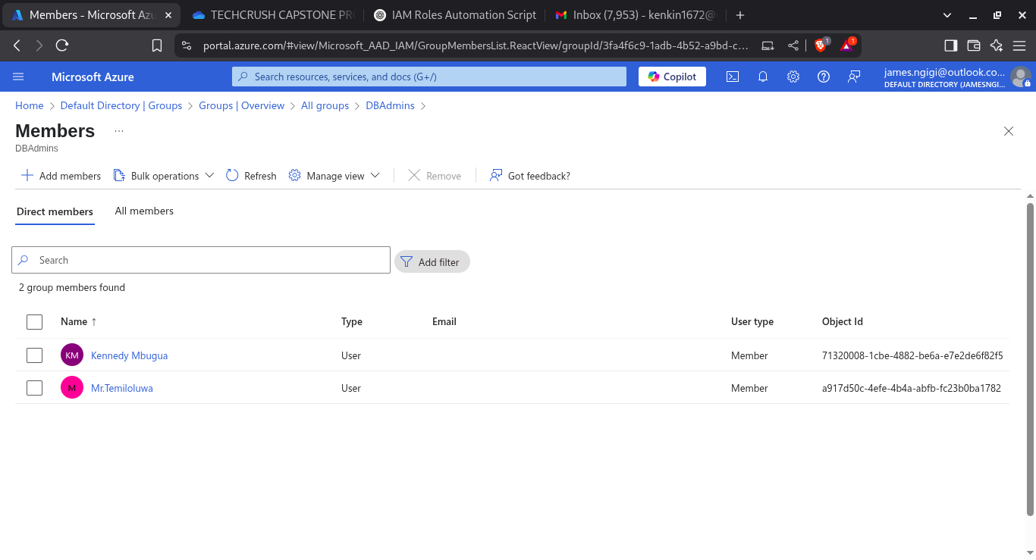
ADDING USERS TO GROUPS

Slide 12

ADDING USERS TO GROUPS
SCRIPT TO ADD USERS TO GROUPS
az ad group member add –group WebAdmins --member-id $(az ad user show --id kennedy.mbugua@jamesngigioutlook.onmicrosoft.com --query id -o tsv)
az ad group member add --group DBAdmins --member-id $(az ad user show --id Mr.temiloluwa@jamesngigioutlook.onmicrosoft.com --query id -o tsv

Slide 13
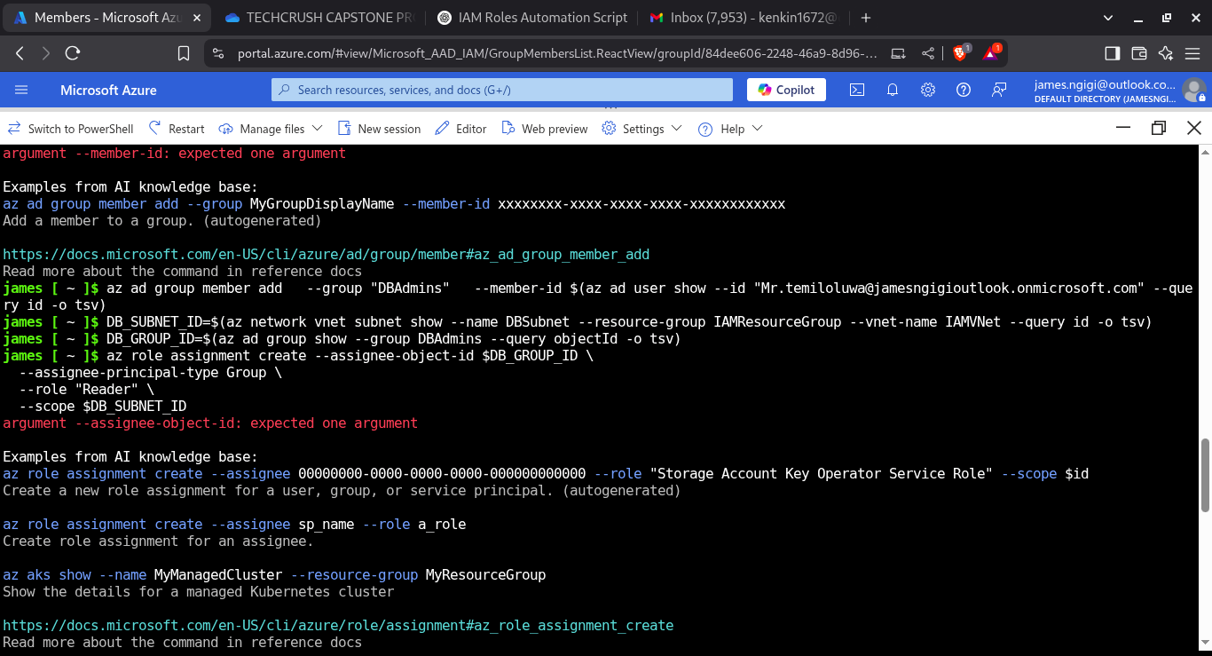
3. Assign Reader role to DBAdmins for DB subnet resources.
Assigning Reader role to DBAdmins on DB subnet
SCRIPT TO Get the subnet ID for DB subnet and getting the object ID of the DBAdmins group
DB_SUBNET_ID=$(az network vnet subnet show
--name "DBSubnet"
--resource-group "IAMResourceGroup"
--vnet-name "IAMVNet"
--query id -o tsv)

Slide 14
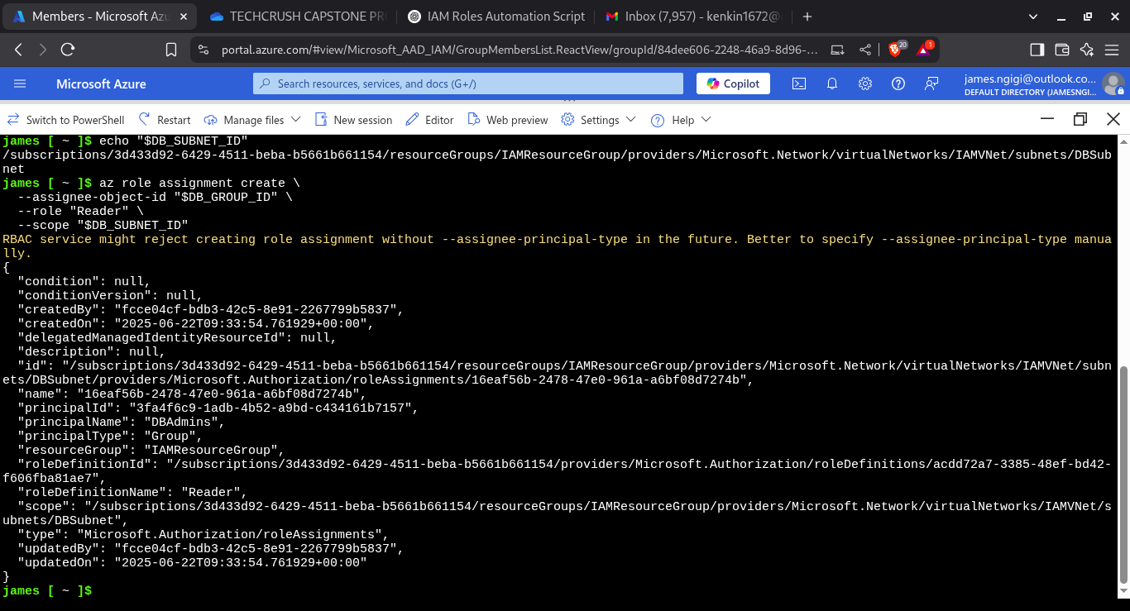
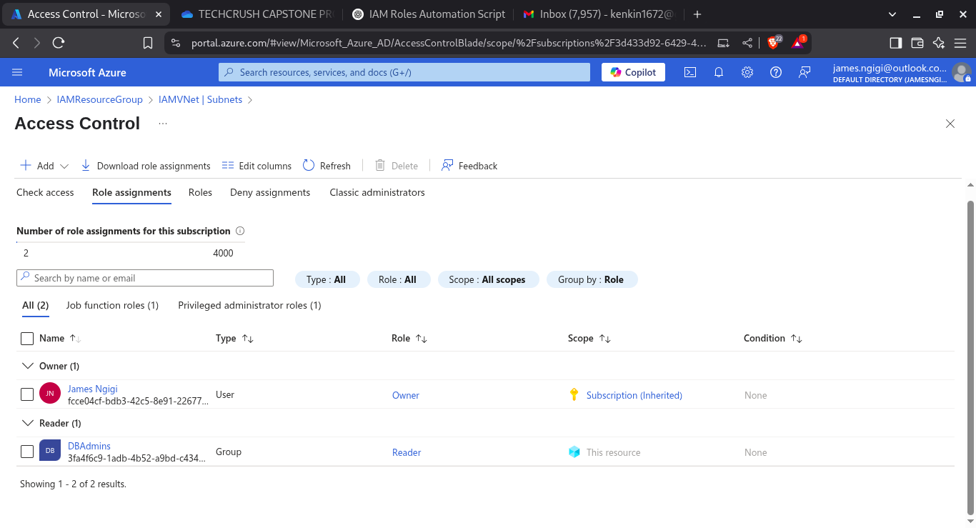
ASSIGNING READER ROLE TO DBADMINS ON DB SUBNET
SCRIPT TO ASSIGN READER ROLE TO DBADMINS ON DB SUBNET.
az role assignment create --assignee-object-id "$DB_GROUP_ID" --role "Reader" --scope "$DB_SUBNET_ID

